Slide 1
Conditional and Loop
PPBO 3
Java

Slide 2
MATERI PERTEMUAN 3
01
02
Conditional
Loop
if / …else / …else if
switch…case
ternary
for
while
do … while
for each

Slide 3
Conditional

Slide 4
Conditional (kondisional) adalah perintah yang digunakan untuk menangani percabangan proses yang memerlukan pemilihan.

Slide 5
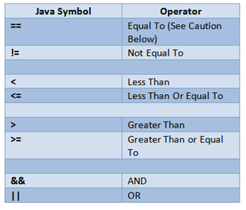
Relational Operators
Logical Operators

Slide 6
if / ...else / …else if

Slide 7
if
Statement if hanya memiliki satu kondisi. Artinya, satu atau beberapa instruksi akan dijalankan apabila kondisinya dipenuhi :
public class DemoIf {
public static void main(String[] args) {
double IPK = 3.5;
if (IPK > 3.25) {
System.out.println("IPK tinggi");
}
}
}

Slide 8
if…else
Konstruksi if ... else sedikit berbeda dengan konstruksi if. Dalam konstruksi if ... else, jika sebuah kondisi tidak terpenuhi maka program akan mencari kondisi yang lain yang ada atau menjalankan instruksi yang berada di luar bagian dari kondisi yang tidak terpenuhi.
public class DemoIfElse {
public static void main(String[] args) {
double IPK = 2.5;
if (IPK > 3.25) {
System.out.println("IPK tinggi");
}
else {
System.out.println("IPK rendah");
}
}
}

Slide 9
if…else if
Statemen if ... else if digunakan apabila ada lebih dari satu kondisi yang ingin diperiksa dalam program:
public class DemoIfElseIf {
public static void main(String[] args) {
double IPK = 3.1;
if (IPK > 3.25) {
System.out.println("IPK tinggi");
}
else if (IPK > 2.75 && IPK <= 3.25) {
System.out.println("IPK cukup");
}
else {
System.out.println("IPK rendah");
}
}
}
Notes:
sabi and or operator di parameter

Slide 10
nested if
Statemen nested if atau if bersarang apabila ada kondisi bertingkat, setelah kondisi pertama terpenuhi akan ada kondisi lain yang diperiksa, kemudian apabila kondisi tersebut dipenuhi akan ada kondisi berikutnya lagi yang diperiksa, dan seterusnya.
public class NestedIf {
public static void main(String[] args) {
double IPK = 3.5;
int PENGHASILAN_ORTU = 2000000;
if (IPK > 3.25) {
System.out.println("IPK tinggi\n");
if (PENGHASILAN_ORTU > 5000000) {
System.out.println("Mendapatkan bantuan dana pendidikan sebesar 1 kali gaji orang tua");
}
else {
System.out.println("Mendapatkan bantuan dana pendidikan penuh selama kuliah");
}
}
else if (IPK > 2.75 && IPK <= 3.25) {
System.out.println("IPK cukup");
}
else {
System.out.println("IPK rendah");
}
}
}

Slide 11
switch…case

Slide 12
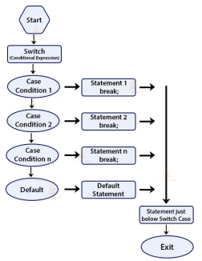
Kondisi switch-case terdiri dari 2 bagian, yakni perintah switch yang memiliki parameter/argumen sebagai variabel yang akan diperiksa/dicocokan dan satu atau lebih perintah case, masing-masing untuk setiap nilai yang ingin diperiksa. Perintah di bawah blok default akan dijalankan jika seluruh kondisi case tidak terpenuhi.
public class Main {
public static void main(String[] args) {
System.out.println("Program Baca Angka\n");
int angka = 0;
switch (angka) {
case 1:
System.out.println("Satu");
break;
case 2:
System.out.println("Dua");
break;
case 3:
System.out.println("Tiga");
break;
case 4:
System.out.println("Empat");
break;
default:
System.out.print("Angka Belum Terdaftar ");
if(angka<1)
System.out.println("(Kekecilan)");
else
System.out.println("(Kegedean)");
break;
}
}
}

Slide 13
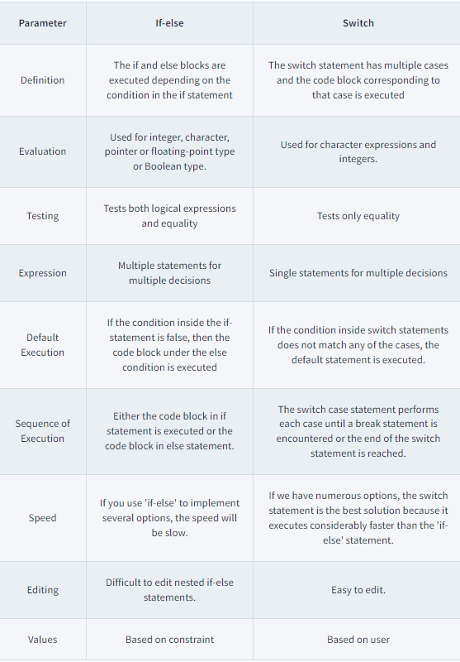
perbedaan if-else dan switch-case

Slide 14
ternary

Slide 15
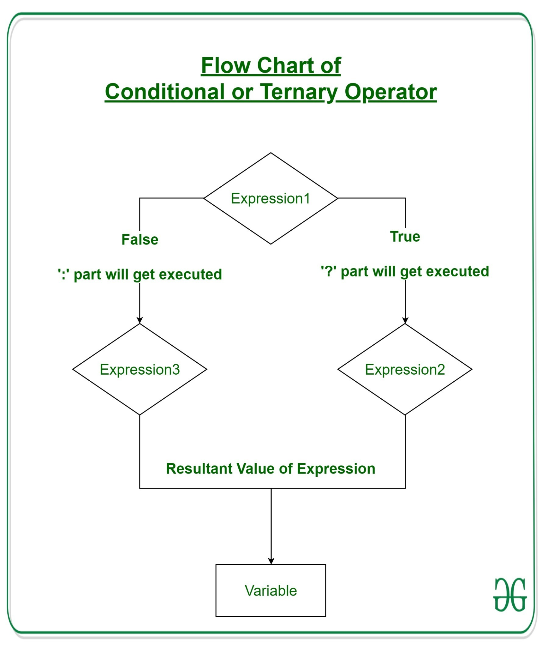
Ternary operator pada java adalah satu-satunya conditional operator yang menggunakan tiga buah operan. Operator ini biasanya digunakan dalam satu baris sehingga akan lebih menyingkat penulisan kode. Ternary bisa digunakan untuk proses assignment suatu nilai.
format : variabel = (Ekspresi) ? (jikaTrue) : (jikaFalse);
public class Main {
public static void main(String[] args) {
double nilai = 71;
boolean biggerThanFifty = (nilai > 50) ? true : false;
if(biggerThanFifty)
System.out.println("Lebih besar dari lima puluh");
else
System.out.println("Tidak lebih besar dari lima puluh");
}
}

Slide 16
Loop

Slide 17
Loop / perulangan adalah sebuah metode programming yang akan mengeksekusi bagian kode tertentu berulang kali selama kondisi yang diberikan masih bernilai TRUE

Slide 18
Jenis Loop
For Loop
Foreach Loop
While Loop
Do … While Loop

Slide 19
For Loop
For loop adalah sebuah loop dengan ciri khas memiliki tiga komponen yaitu inisialisasi, kondisi, dan update yang mana ketiganya dipisahkan menggunakan semicolon (;). For loop termasuk sebagai countable loop
Syntax:
for(/* inisialisasi */ ; /* kondisi */ ; /* update */){
/* yang akan diulang... */
}

Slide 20
Foreach Loop
Foreach loop adalah sebuah loop yang sekaligus mentraverse setiap elemen dari sebuah array atau collection. Foreach loop tidak melacak index yang sedang diiterasi. Foreach loop termasuk sebagai countable loop
Syntax java:
for( dataType element : array ){
/* perulangan */
}
Foreach di bahasa pemrograman lain:
// php // C#
foreach( $array as $element ){ foreach( dataType element in array ){
/* perulangan */ /* perulangan */
} }

Slide 21
While loop
While loop adalah sebuah loop yang dibangun dengan komponen kondisi saja (tidak seperti for loop dengan 3 komponen). Dengan ini, while loop dapat digunakan untuk perulangan dengan kondisi yang lebih luas. While loop termasuk sebagai uncountable loop
Syntax:
while(/* kondisi */){
/* yang akan diulang... */
}

Slide 22
Do … While loop
Do While loop merupakan variant dari while loop di mana proses condition checking dilakukan di akhir perulangan sehingga do while loop menjamin perulangan akan dieksekusi minimal satu kali
Syntax:
do {
/* yang akan diulang... */
} while(/* kondisi */)

Slide 23
NOW
POOR DESIGN
PROGRAMMING MISTAKES
LACK OF ADAPTABILITY

Slide 24
FUTURE
BRANDING
POSITIONING
ADAPTABILITY

Slide 25
MAJOR REQUIREMENTS
IMAGES
USER EXPERIENCE
INFORMATION
Despite being red, Mars is a cold place, not hot. It’s full of iron oxide dust
Venus has a beautiful name and is the second planet from the Sun
Mercury is the closest planet to the Sun and the smallest in our Solar System

Slide 26
TABLE OF CONTENTS
01
04
About the Project
Sneak Peek
02
05
Major Requirements
Project Stages
03
06
Project Goals
Our Team
Here you could describe
the topic of the section
Here you could describe
the topic of the section
Here you could describe
the topic of the section
Here you could describe
the topic of the section
Here you could describe
the topic of the section
Here you could describe
the topic of the section

Slide 27
OUR COMPANY
GOSTUDIO
Mercury is the closest planet to the Sun and the smallest one in the Solar System—it’s only a bit larger than our Moon. The planet’s name has nothing to do with the liquid metal since it was
named after the Roman messenger god, Mercury.

Slide 28
WHAT WE ARE WORKING ON
SECURE
ACCESSIBLE
FAST AND RELIABLE
Mercury is the closest planet to the Sun
Despite being red, Mars is a cold place, not hot
Neptune is the farthest planet from the Sun

Slide 29
ABOUT THE PROJECT
Mercury is the closest planet to the Sun and the smallest one in the Solar System—it’s only a bit larger than our Moon. The planet’s name has nothing to do with the liquid metal since it was named after the Roman messenger god, Mercury

Slide 30
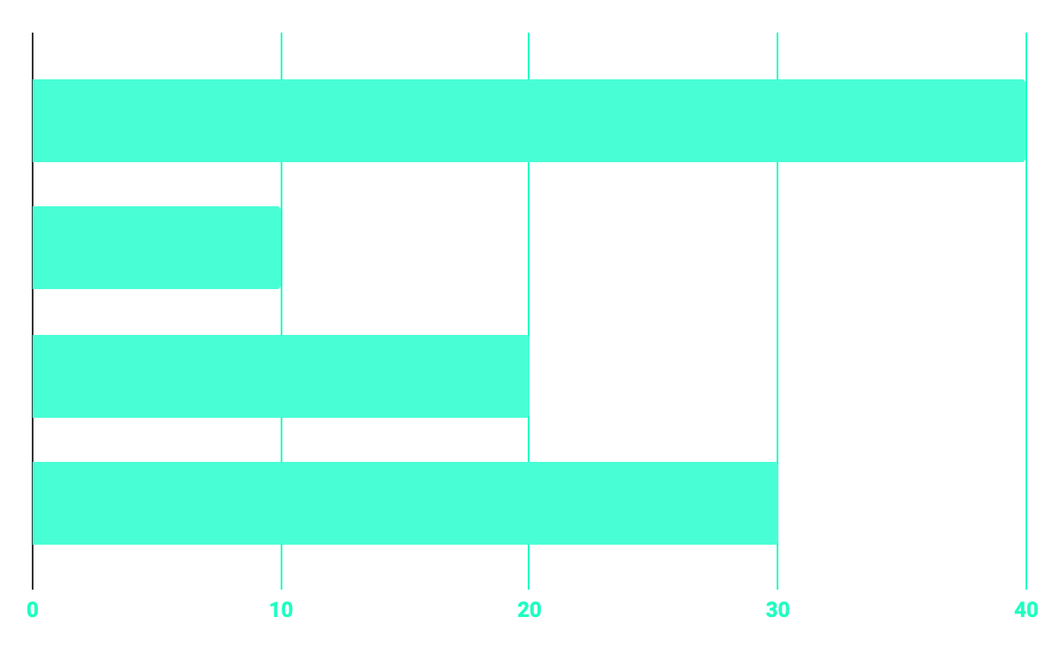
BUDGET
40%
20%
PROGRAMMING
10%
30%
DATABASE
WEB DESIGN
UX RESEARCH

Slide 31
OUR GOALS
EXPANSION
POSITIONING
USABILITY
Neptune is the fourth-largest planet in our Solar System
Venus has a beautiful name and is the second planet from the Sun
Despite being red, Mars is a cold place, not hot. It’s full of iron oxide dust

Slide 32
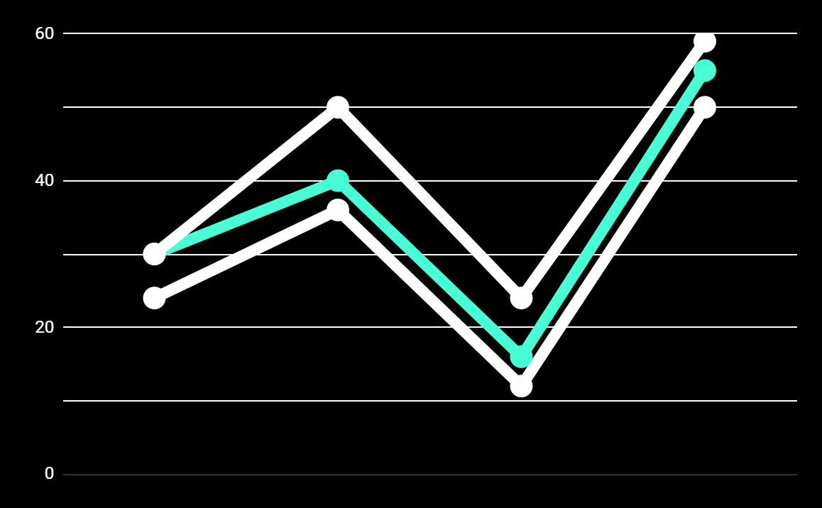
PREDICTED RESULTS
CONVERSIONS NEXT YEAR
+20%
MONTHLY VISITS
+33%
CONVERSION RATE
+40%
ANNUAL ORDERS

Slide 33
SNEAK PEEK
HEADER
TEXT
SLIDER
ICONS

Slide 34
A VIDEO IS A GOOD IDEA
Insert your multimedia content here

Slide 35
PROJECT STAGES
STEP 2
STEP 1
STEP 3
Venus has a beautiful name and is the second planet from the Sun
Despite being red, Mars is a cold place, not hot. It’s full of iron oxide dust
Saturn is a gas giant, composed mostly of hydrogen and helium

Slide 36
OUR TIMELINE
WEEK 1
WEEK 3
BETA
RELEASE
FINAL
VERSION
WEEK 2
WEEK 4
Improvements
Increased traffic
Focus group
Progress review

Slide 37
OUR PARTNERS
MARS
VENUS
MERCURY
Mercury is the closest planet to the Sun and the smallest one in our Solar System
Despite being red, Mars is a cold place, not hot. It’s full of iron oxide dust
Venus has a beautiful name and is the second planet from the Sun

Slide 38



THE TEAM
JENNA DOE
JOHN DOE
JIMMY DOE
You can replace the image on the screen with your own
You can replace the image on the screen with your own
You can replace the image on the screen with your own

Slide 39
THANKS!
Does anyone have any question?
addyouremail@freepik.com
+91 620 421 838
yourcompany.com

Slide 40
CREDITS
This is where you give credit to the ones who are part of this project.
Presentation template by Slidesgo
Icons by Flaticon
Infographics by Freepik
Images created by Freepik
Author introduction slide photo created by Freepik
Text & Image slide photo created by Freepik

Slide 41
RESOURCES
Did you like the resources on this template? Get them for free at our other websites.
PHOTOS
Young businessman with hands in his pocket talking on mobile phone
Smiling ethnic woman with gray laptop
Smiling young man busy in texting message to someone
VECTORS
Flat computer engineering concept
Circuit of user experience
Timeline infographic
Logotype collection
Flat social media multimedia player templa
Gradient technology logo template collection
Digital marketing landing page template
Colorful responsive landing page
Modern web design concept with hand drawn style
App development concept with flat design

Slide 42
Instructions for use
In order to use this template, you must credit Slidesgo by keeping the Thanks slide.
You are allowed to:
- Modify this template.
- Use it for both personal and commercial projects.
You are not allowed to:
- Sublicense, sell or rent any of Slidesgo Content (or a modified version of Slidesgo Content).
- Distribute Slidesgo Content unless it has been expressly authorized by Slidesgo.
- Include Slidesgo Content in an online or offline database or file.
- Offer Slidesgo templates (or modified versions of Slidesgo templates) for download.
- Acquire the copyright of Slidesgo Content.
For more information about editing slides, please read our FAQs:
https://slidesgo.com/faqs

Slide 43
Fonts & colors used
This presentation has been made using the following fonts:
Roboto
(https://fonts.google.com/specimen/Roboto+bold)
Roboto
(https://fonts.google.com/specimen/Roboto+Thin)
#48ffd5
#0e2a47
#ffffff

Slide 44





Storyset
Create your Story with our illustrated concepts. Choose the style you like the most, edit its colors, pick the background and layers you want to show and bring them to life with the animator panel! It will boost your presentation. Check out How it Works.
Pana
Amico
Bro
Rafiki
Cuate

Slide 45
Use our editable graphic resources...
You can easily resize these resources without losing quality. To change the color, just ungroup the resource and click on the object you want to change. Then, click on the paint bucket and select the color you want. Group the resource again when you’re done. You can also look for more infographics on Slidesgo.

Slide 48
JANUARY
FEBRUARY
MARCH
APRIL
MAY
JUNE
PHASE 1
Task 1
Task 2
PHASE 2
Task 1
Task 2
JANUARY
FEBRUARY
MARCH
APRIL
PHASE 1
Task 1
Task 2

Slide 51
...and our sets of editable icons
You can resize these icons without losing quality.
You can change the stroke and fill color; just select the icon and click on the paint bucket/pen.
In Google Slides, you can also use Flaticon’s extension, allowing you to customize and add even more icons.

Slide 52
Educational Icons
Medical Icons

Slide 53
Business Icons
Teamwork Icons

Slide 54
Help & Support Icons
Avatar Icons

Slide 55
Creative Process Icons
Performing Arts Icons

Slide 56
Nature Icons

Slide 57
SEO & Marketing Icons

Slide 58


